Slide 1
WALMART STORE SALES PREDICTION - FORECASTING

Slide 2
Agenda
Business context, goal and approach
Data understanding
Merging Data Sets
Exploratory Analysis
Data audit and preparation
Feature Engineering
Model building and execution
Model comparison
Residual Plots, Decile Analysis
Predict on final test data
Conclusion

Slide 3
Business problem
Business Context:
The objective is predicting store sales using historical markdown data. We are provided with historical sales data for 45 Walmart stores located in different regions. Each store contains a number of departments, and we are tasked with predicting the department-wide sales for each store.
Business Goals:
Predicting the department-wide sales for each store.
Approach:
Analyse relationship of all variables with weekly sales.
Use regression and ML techniques to predict department wide sales for each store.

Slide 4
Data understanding
The data is divided into 3 sets, (train, store, features) and (test, store, features which we need to merge.
Strore.csv has store number, type and size of the stores.
Features.csv:
Store - the store number
Date - the week
Temperature - average temperature in the region
Fuel_Price - cost of fuel in the region
Train.csv:
Store - the store number
Dept - the department number
Date - the week
Weekly_Sales - sales for the given department in the given store
IsHoliday - whether the week is a special holiday week
Test.csv has all columns that Train.csv has except weekly_sales, which we have to predict.

Slide 5
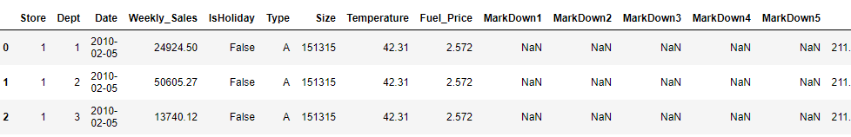
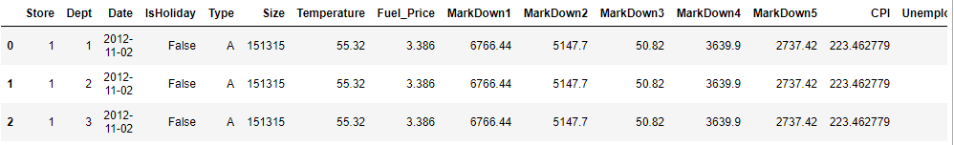
Merging Data Sets
# Merging the stores, features and train data
train_data = pd.merge(train_data, store_data, on = ['Store'], how = 'inner')
train_data = pd.merge(train_data, feature_data, on = ['Store', 'Date','IsHoliday'], how = 'inner’)
train_data.head(5)
# Merging the stores, features and test data
test_data = pd.merge(test_data, store_data, on = ['Store'], how = 'inner')
test_data = pd.merge(test_data, feature_data, on = ['Store', 'Date','IsHoliday'], how = 'inner’)
test_data.head(5)

Slide 6
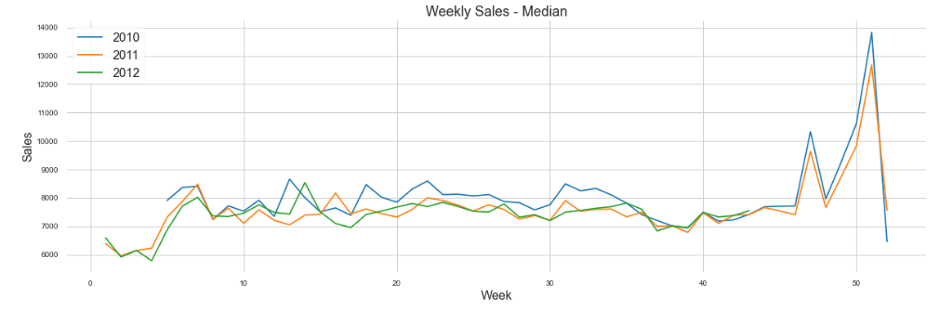
Exploratory Analysis
Thanks giving and Christmas seem to have the best impact on sales. This is followed by a peak during September that is around labor day. There is also a spike during February (8th, 9th week) Superbowl. Overall key holidays seem to have an positive impact on sales.

Slide 7
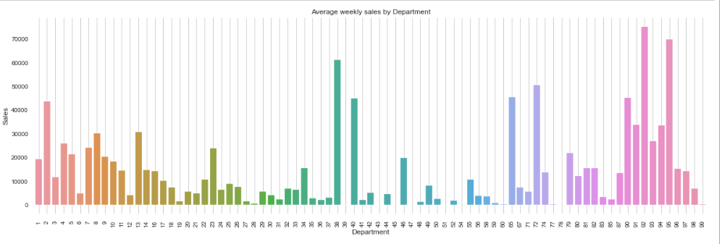
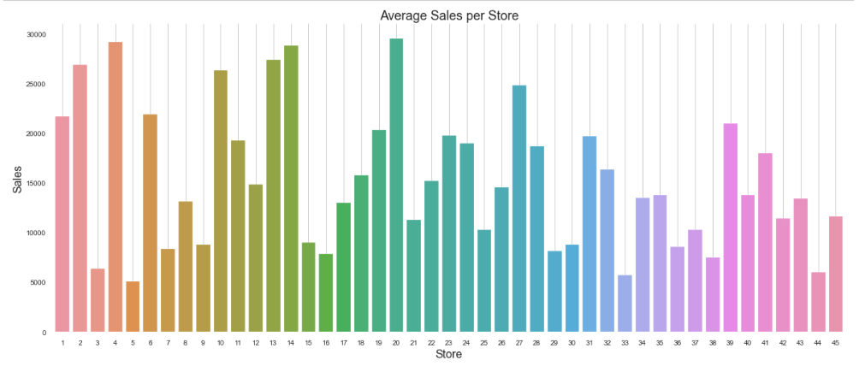
Exploratory Analysis
Stores 4. 14, 20 have the highest weekly sales over the data years.
Departments 38, 92, 95 have the highest weekly sales

Slide 8
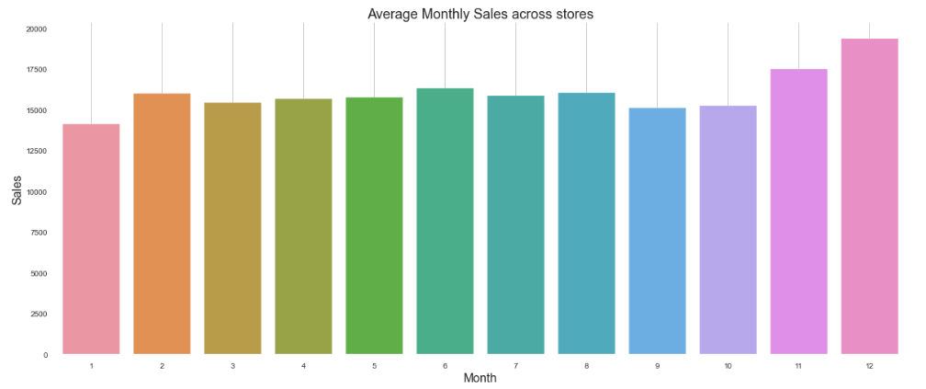
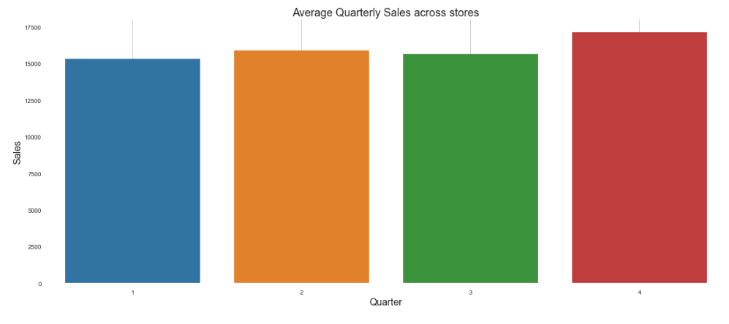
Exploratory Analysis
As expected the highest sales is observed over the year end months, November and December due to thanks giving, Christmas and new year.
Also, the 4th quarter sales beat the other 3 quarters handsomely.

Slide 9
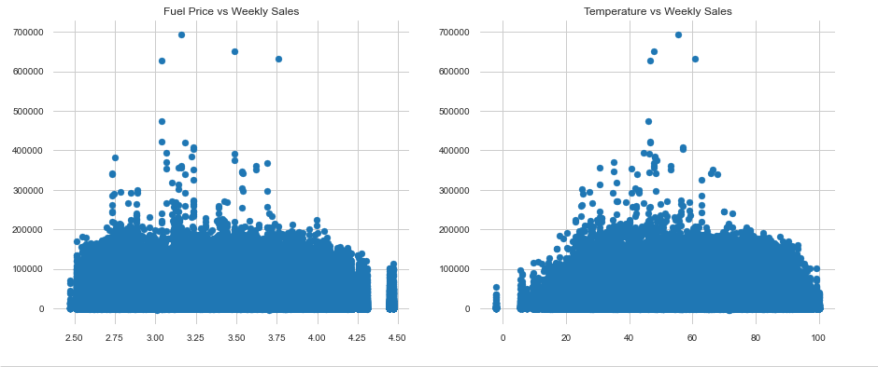
Exploratory Analysis
Fuel_price and temperature do not show much impact on weekly_sales. The spread seems even, no trends can be identified.

Slide 10
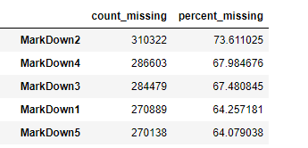
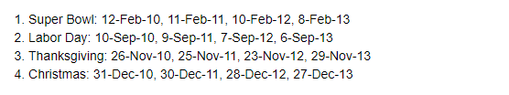
Data audit and preparation
Renaming columns appropriately – no name change is required
Check data types - Done
Check for missing values - missing value treatment done
Apply Outlier treatment -- done
Check for duplicates - removed duplicates
Any type conversion required - not required
Any special characters that need to removed/replaced – no special characters
Markdown1, Markdown2, Markdown3, Markdown4, Markdown5 have over 30% missing values, hence dropped them.
4 holidays fall as under, created 4 columns for 4 holidays and then can dropped IsHoliday column.

Slide 11
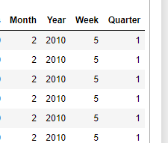
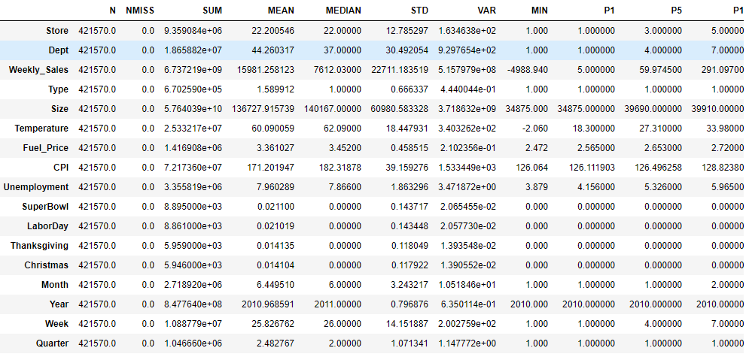
Data audit and preparation
Changed type of Date variable to datetime and extracted month, Year, week and quarter. Dropped Date column.
Create dummies for store Type
Generated data audit report for analysis.

Slide 12
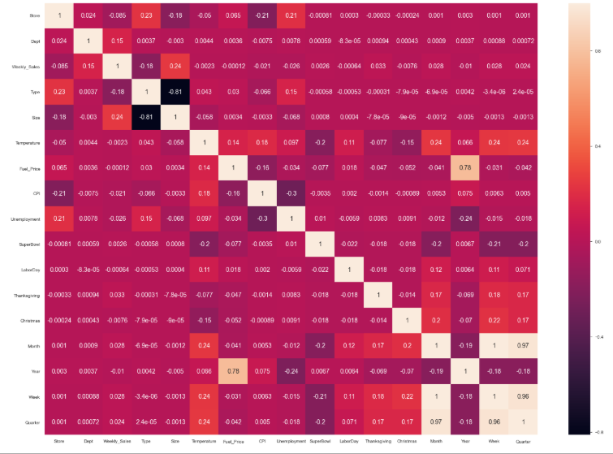
Data audit and preparation
Temperature, Fuel_price, CPI, Unemployment show very less correlation with weekly sales.
The derived variables like month, year, week, quarter show less correlation with weekly_sales.
Week and year are needed to differentiate same week for store and department.
Year and Fuel_price shows strong correlation with each other
Size shows good correlation with weekly_sales

Slide 13
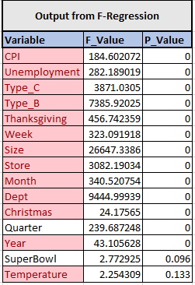
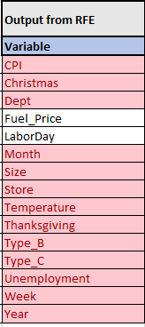
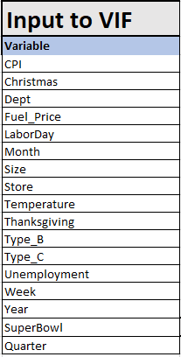
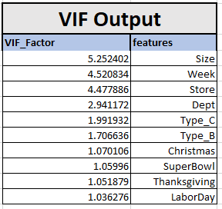
Feature Engineering
We performed RFE and F-regression to understand the most important variables. VIF was further used to discard variables that were introducing noise.

Slide 14
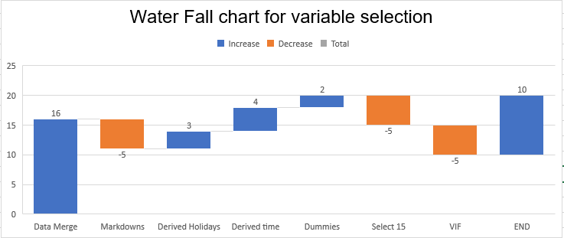
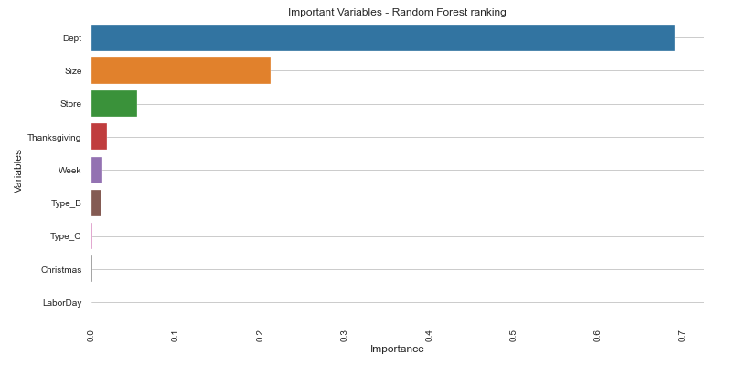
Feature Engineering
Dropped MarkDown1, MarkDown2, MarkDown3, MarkDown4, MarkDown5 as the missing percentage was greater than 25%.
Created 4 columns for 4 holidays and then can dropped IsHoliday column.
Extracted month, Year, week and quarter Data variable and dropped Date.
One hot encoding for categorical variable - Type.
Select most important 15 from RFE and F-regression.
After taking into account VIF factor, remaining variables are 10.

Slide 15
Model building and execution
Below models were tried:
Sklearn Linear regression
Random Forest regression
Xtreme Gradient Boost regression
Train data(train.csv) was further split into train and test. Model was built an train and validating on test before actual prediction on the provided test.csv file.
Test to Train split was 30% and 70% .
Three techniques - XGBRegressor, LinearRegression, RandomForestRegressor were used and compared against R2 score, WMAE.
Since, the weeks including the holidays are weighted five times higher in the evaluation than non-holiday weeks, our models would be evaluated based on Weighted Mean Absolute Error (WMAE), with a weight of 5 for Holiday Weeks and 1 otherwise.
Using SVR with GridSearchCV or KNN with GridSearchCV, even with 80 to 120 models caused the machine to hang or run on for hours (ultimately the process was killed).
Model was validated with error distribution analysis and decile analysis.

Slide 16
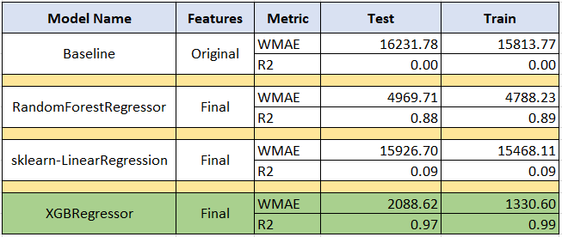
Model comparison
Final Model:
XGBRegressor is our top and final model as it does better in terms of R2 score and WMAE on test and train is lowest.
Best Parameters for the models:
LinearRegression:
fit_intercept:True, copy_X:True, normalize:False
RandomForestRegressor:
max_depth: 10, n_estimators: 30, bootstrap: True, CV: 5
XGBRegressor:
learning_rate: 0.05, n_estimators: 1000, max_depth: 10, n_jobs: -1

Slide 17
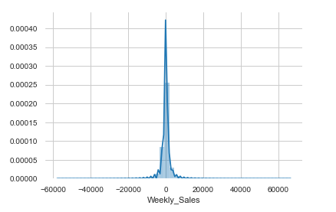
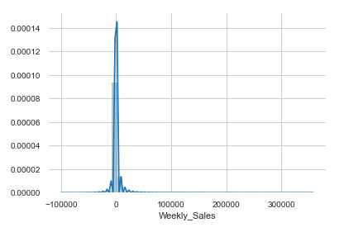
Residual Plots
Residual plots for both train and test below. We observe that since we have an accuracy of close to 99%, errors are tending towards zero.
Train Errors
Test Errors

Slide 18
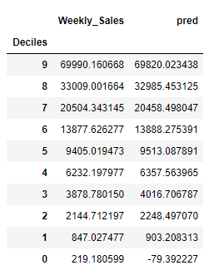
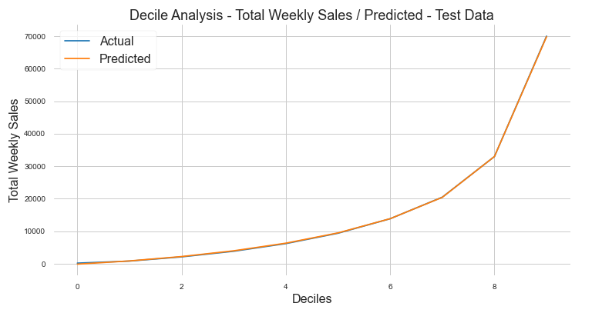
Decile Analysis
We observe that the actual and predicted deciles are very close to each and plot overlaps each other.
Test Data

Slide 19
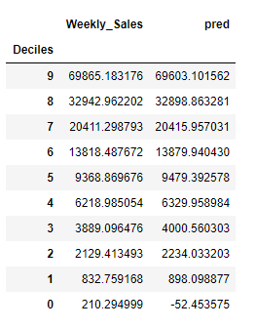
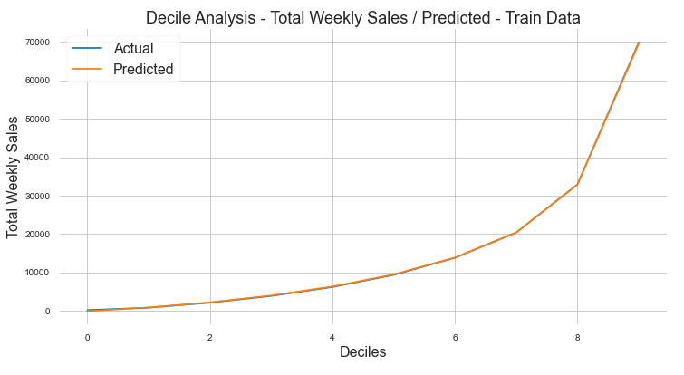
Decile Analysis
We observe that the actual and predicted deciles are very close to each and plot overlaps each other.
Train Data

Slide 20
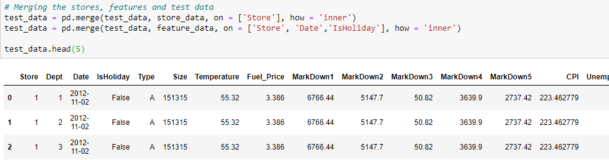

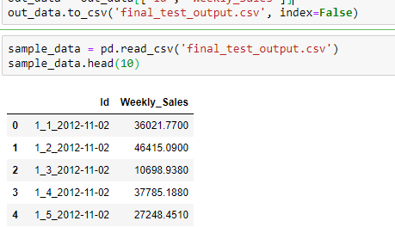
Predict on final test data
Data from test.csv merged with features and stores data set.
All data manipulation steps apply to the test data from test.csv file.
All derived variable created for test data.
All dummy variable creation steps apply to test data.
Test data would contain the finalized list of variables after the variable reduction steps.
Weekly_Sales predicted using the selected XGBRegressor
We could you the saved pickle file as well.

Slide 21
Conclusion
We were successfully able to predict the weekly sales on the test.csv file in the prescribed format.
We were able to compare the models with Weighted Mean Absolute Error (WMAE) as the weeks including the holidays are weighted five times higher in the evaluation than non-holiday weeks.
The chosen model, XGBRegressor, showed a WMAE of 1330 and 2088 on train and test respectively, which was significantly lower than the other models.
With decile analysis, we compared the actual with predicted and found that the overall difference in the deciles were quite low as the plotted curves overlapped each other.
We saved the chosen model in a pickle for later use.

Slide 22
Thank You !

